Slide 1



2024.12.11
Master Degree Thesis
Vision-based Intelligent Gait Environment Detection System for Soft Ankle Exoskeleton
Gayoung Yang
Intelligence Robotics Lab
School of Intelligent Mechatronics Engineering
Sejong University

Slide 2
Index
I. Introduction
II. Soft Exosuit
1. Soft Exosuit Prototype
2. Control Strategy
III. Environment Recognition System
1. YOLO-LSTM based approach
2. EfficientNet-HED based approach
IV. Experiments
V. Results
1. YOLO-LSTM based approach
2. EfficientNet-HED based approach
VI. Conclusion
Notes:
Here is the content of this presentation

Slide 3
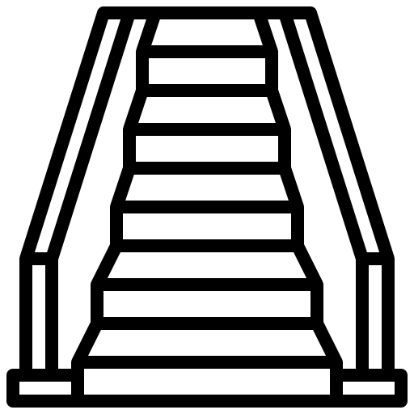

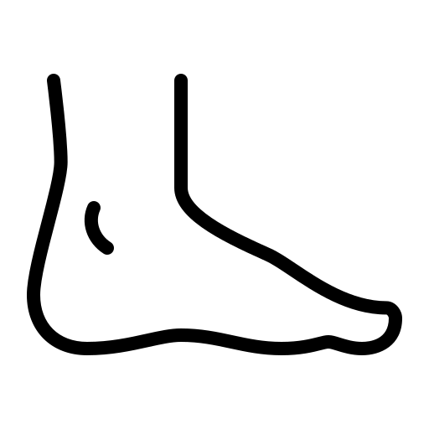

I. Introduction
Stroke Patients
functional impairments & gait disturbances
foot drop : reduction in foot clearance (swing phase of gait cycle)
stair ambulation
common activity
challenging task : joint range, muscular moment ↑
ascent: insufficient clearance between foot & stair nosing
Lower Limb Exoskeleton
- assist gait for stair environment
clearance
nosing

Slide 4


I. Introduction
Exoskeleton
inertial measurement unit (IMU) & insole sensor
provide current state of gait
Limitation: Lack of prior environmental information
vision – based perception
human
peripheral vision
vision system for exoskeleton
visual recognition of step location
continuous monitoring stage
awareness of surrounding environment
locomotion guidance

Slide 5
I. Introduction
environment classification + exoskeleton
Deep learning-based methodologies
[challenge]
- transition phase accuracy
- stroke patient consideration
influence robotics field
Vision-based Intelligent gait environment detection algorithm for ankle exosuit
Integration of deep learning-based environment classification into exoskeleton application
detailed gait environment classification (YOLOv8) + spatio-temporal feature extraction (LSTM)
soft ankle exosuit aimed at stroke patients

Slide 6
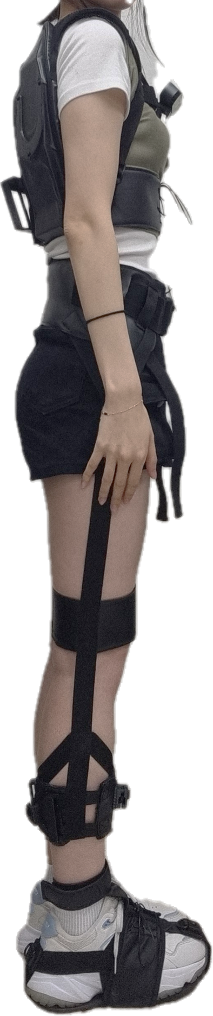
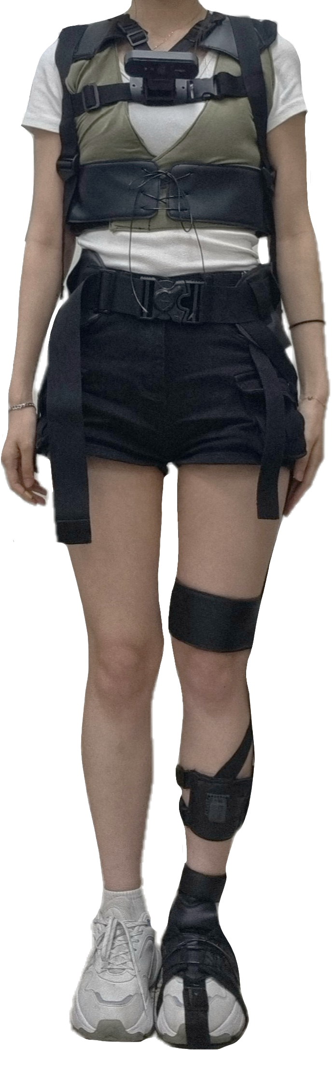
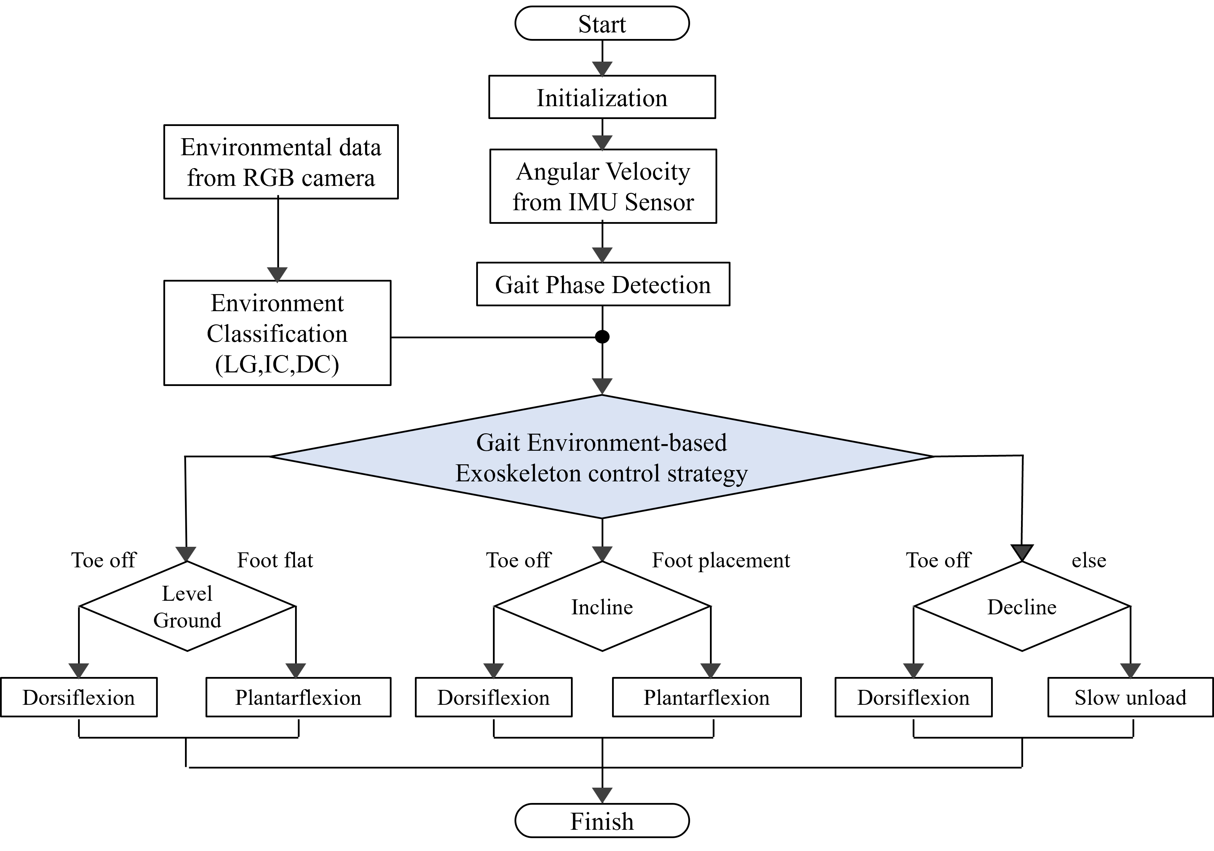
II . Soft Exosuit
Exosuit Design
Control Strategy
armour vest
camera: capture
gait environment
waist belt
curve strap
thigh brace
IMU: gait phase detection
shin brace
foot wearable
flexible and lightweight materials
Bowden cable-driven method
flowchart of gait-environment-based exoskeleton control strategy

Slide 7
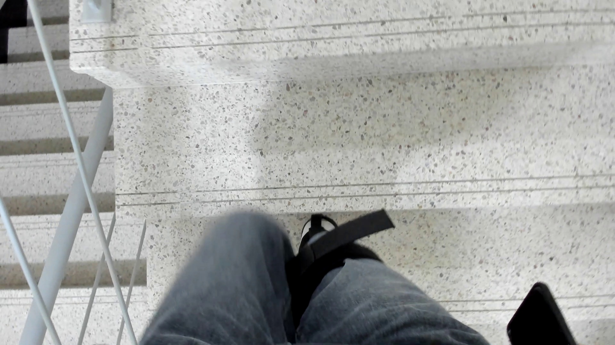
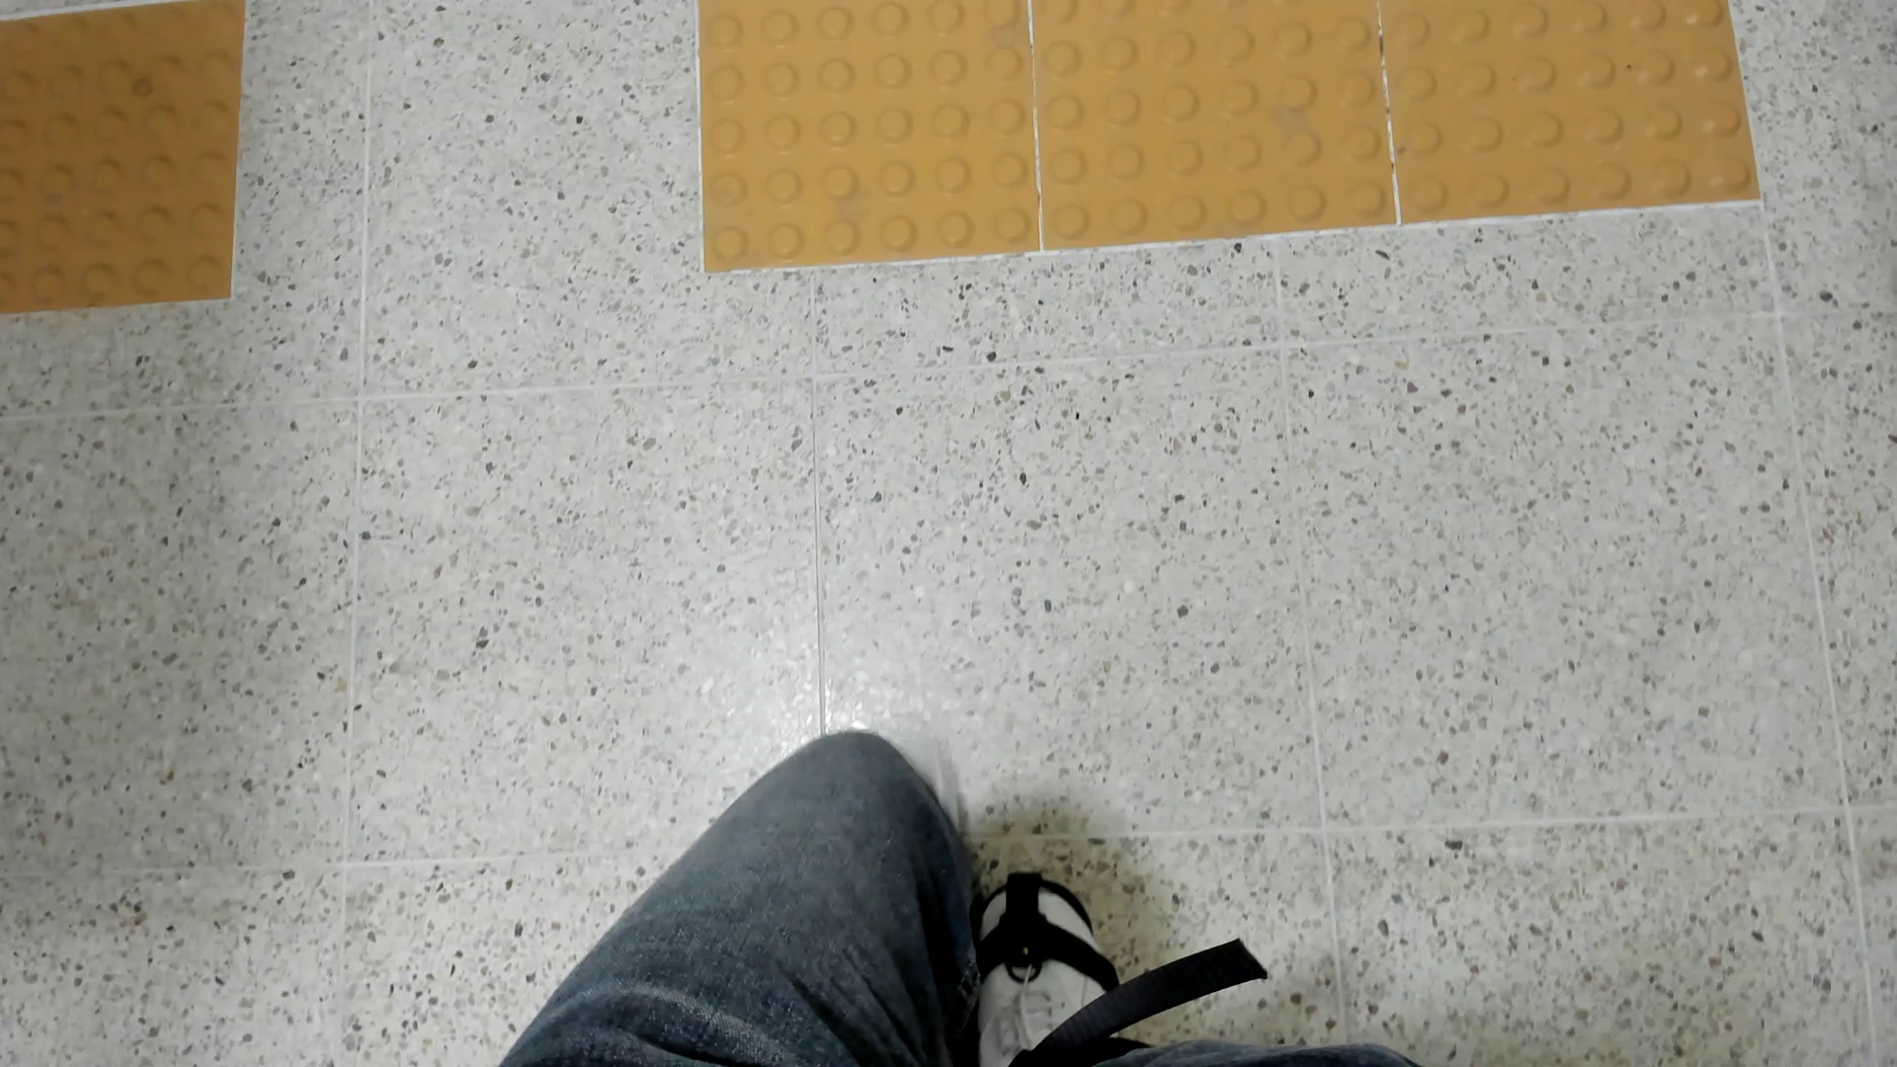
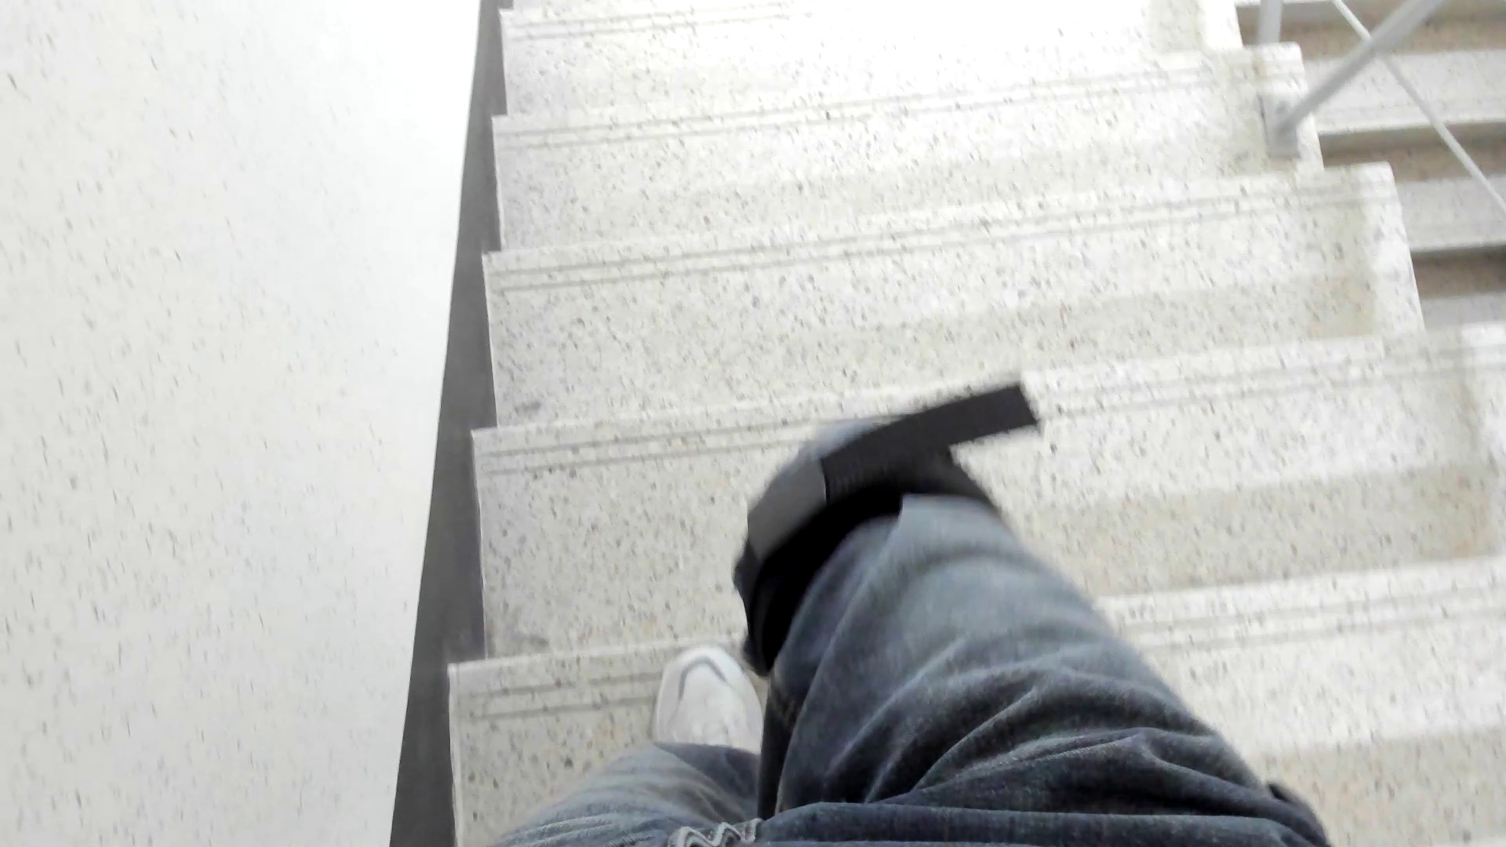
III . Environment Recognition System
Data Acquisition · Class Definition
IC
IC prev
initial incline
IC
mid-incline
IC next
final incline
[customized dataset]
level ground and stair environment
960 x 540 pixel
training: 16,000 | valid: 2,000 | test: 2000
-> 8:1:1
LG
LG
level ground
valid
train
test
initial decline
DC
DC prev
DC
mid-decline
DC next
final decline

Slide 8
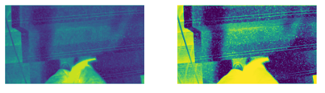
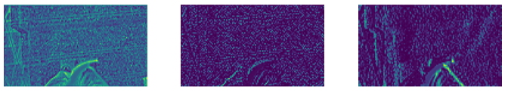
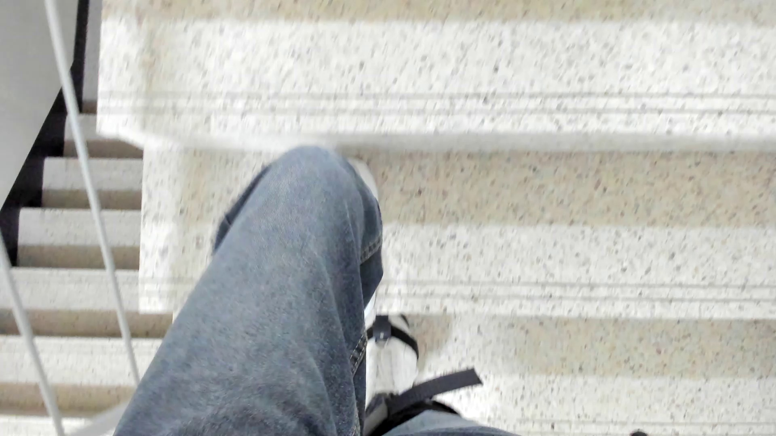



III . Environment Recognition System
YOLOv8 Model Training
YOLOv8 Environment Classification
object detection framework: one-stage detection approach
provide real-time contextual insight for frame
Rapid Detection: critical for detecting gait environment transitions
Spatial analysis: Effective in analyzing global spatial information
YOLOv8
[Framework]
Trained using PyTorch on:
Intel i5-13600KF CPU
NVIDIA RTX 3070 GPU
Gait
sequential time-series data
consider past and future context
- class probability
- top 1 class
[Hyperparameter]
Epohcs: 100
Batch size: 16
Learning Rate: 0.0001
Optimizer: Adam
input image
frame (i)
LSTM
output feature
(8)
feature map

Slide 9



III . Environment Recognition System
LSTM-Based Spatio-Temporal Feature Extraction
LSTM-Based Spatio-Temporal Feature Extraction
extract temporal features: adapting to environment transitions
Data Preparation
Class Labeling
Model Training
Frame Sampling: 20 FPS
1 class for 10 frames,
with a stride of 5 (4 labels/sec)
Sequence shape: (1714, 10,8)
Most probable Class:
Chosen from YOLO frame-wise probabilities
Maximum Voting & Average Voting
1000 epochs
batch sizes : 32
learning rate: 0.001
Adam optimizer
i+10
LG
YOLOv8
feature
frame (i)
LSTM
LSTM
softmax
DC
LSTM
LSTM
environment classification
IC
input image
frame (i)
feature sequence
(10,8)
LSTM1 layer
LSTM2 layer
class
(3)
output feature
(8)
[class probability, top 1 class]
fully connected layer
(128)

Slide 10
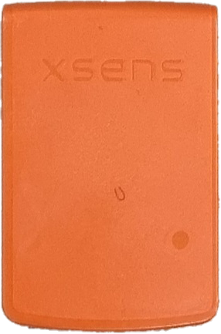
IV . Experiments
Experimental Setup
Level Ground
Exosuit
Camera
Incline
gait environment frame
Decline
Condition
without exosuit (No Exo)
Exosuit worn but unpowered (Exo Off)
Exosuit worn and powerd (Exo On)
10-minute familarization with exosuit
20-minute rest between conditions
Surface EMG Sensors:
Medial gastrocnemius
(MG)
Tibialis anterior
(TA)
Muscle Activation
MVC Normalization
fourth-order Butterworth filter (6Hz cutoff frequency)
Inertial sensor
: Xsens MTw Awinda
ankle joint angles (sagittal plane)

Slide 11
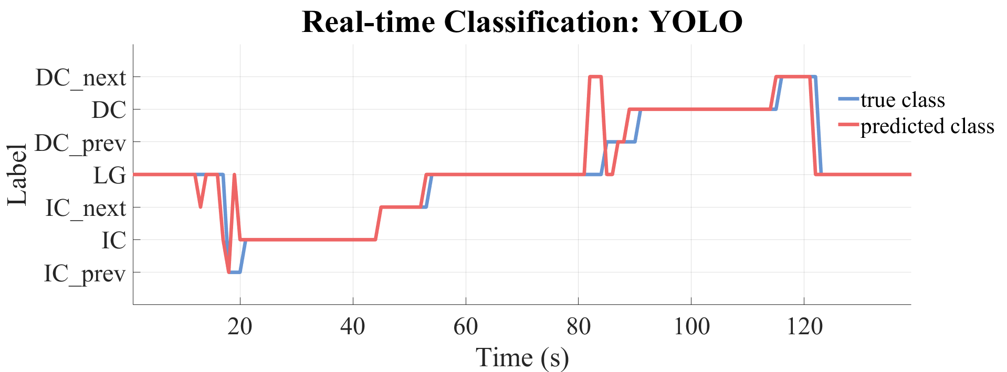
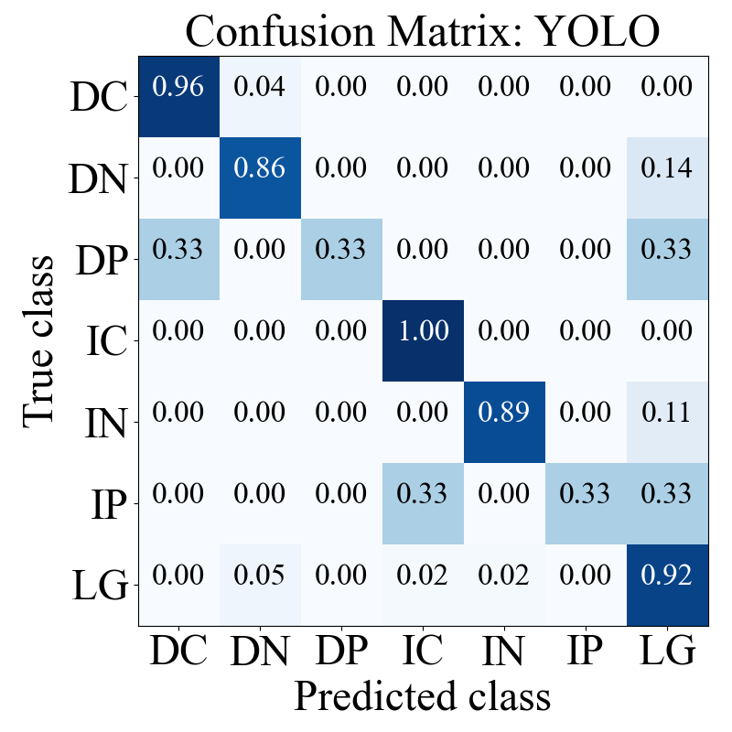
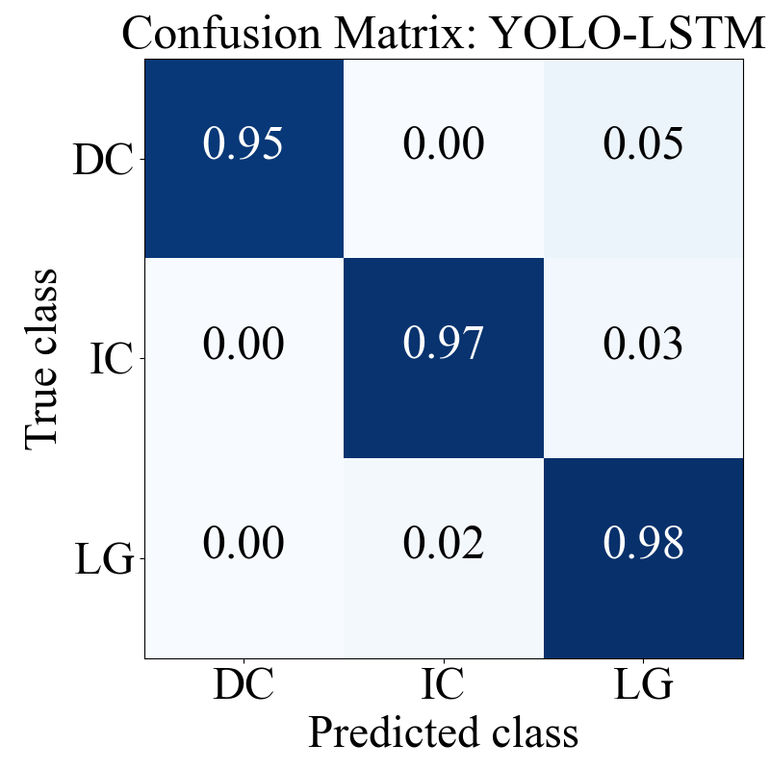
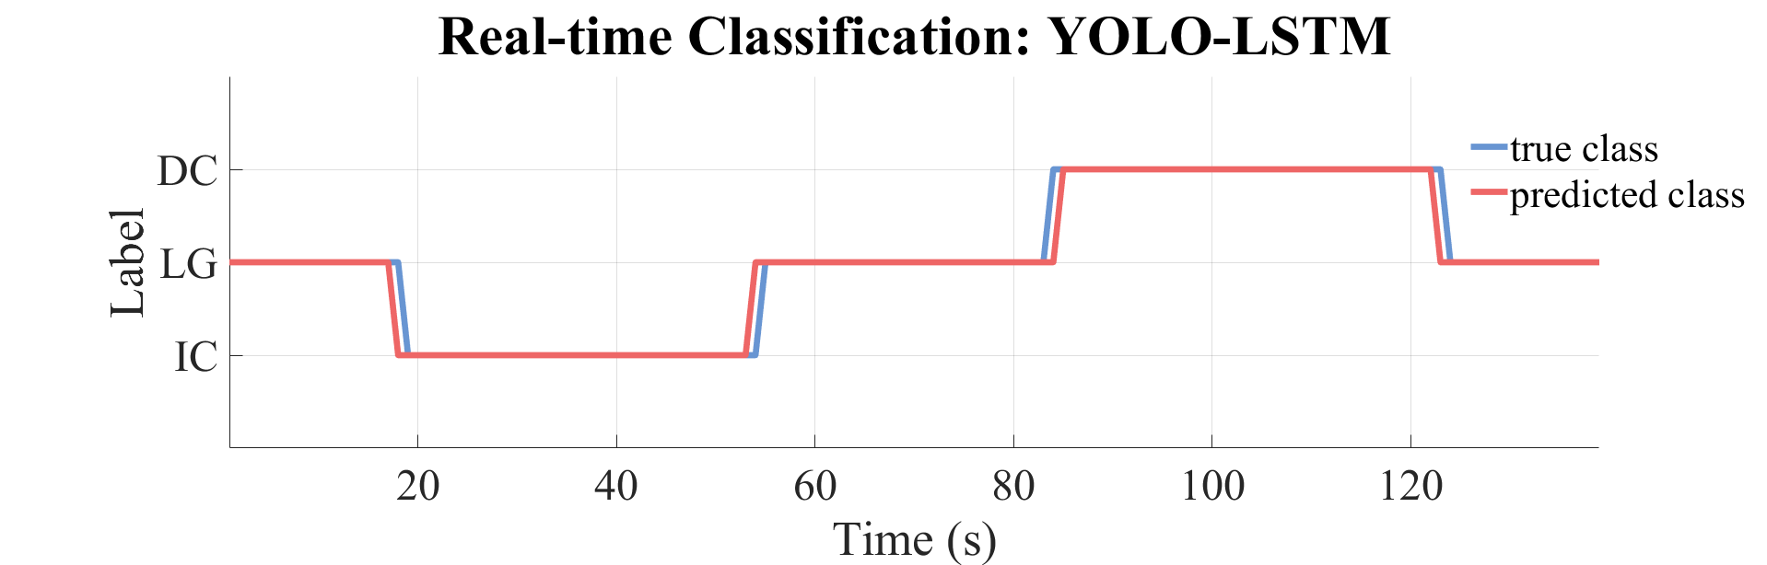
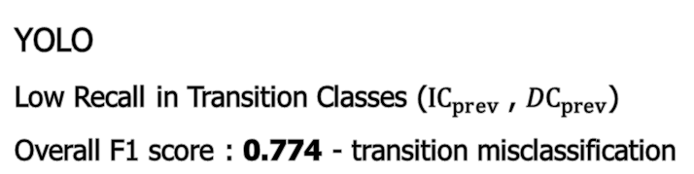
V . Results
Real-Time Environment Classification Performance
YOLO
Low Recall in Transition Classes (${IC}_{prev}$ , ${DC}_{prev}$)
Overall F1 score : 0.774 - transition misclassification
YOLO
Misclassified LG as stairs 1.5s (6 frames) before stair transition
YOLO - LSTM
Overall F1 score : 0.971 - balanced classification performance
YOLO - LSTM
rapid and accurate classification during the transition phase

Slide 12
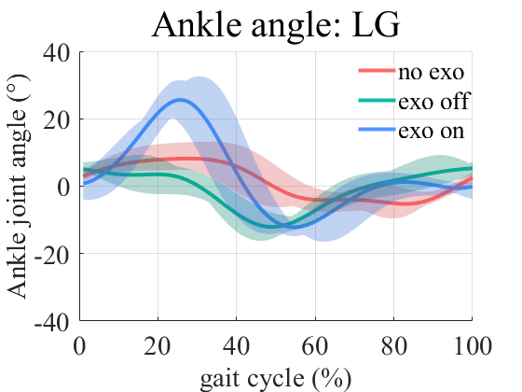
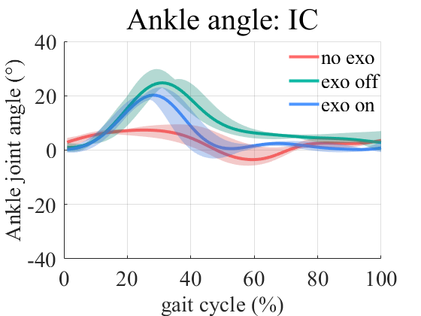
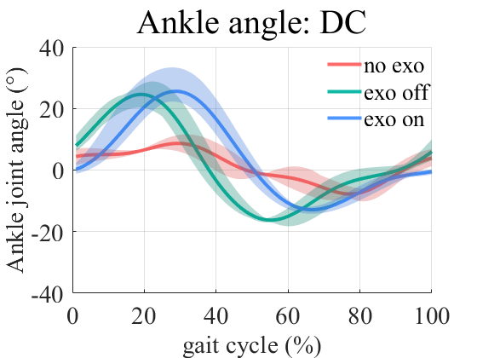
V . Results
Joint Kinematics
(A)
(B)
(C)
peak ankle joint dorsiflexion angle
LG
IC
DC
no exo
8.88° ± 3.95°
7.92° ± 1.48°
9.14° ± 2.27°
LG: significant increase with the exo on
IC: increase with the exo on, exo off
exo off
6.74° ± 2.08°
25.99° ± 2.78°
25.08° ± 3.63°
exo on
27.13° ± 5.71°
21.06° ± 2.08°
25.65° ± 5.16°

Slide 13
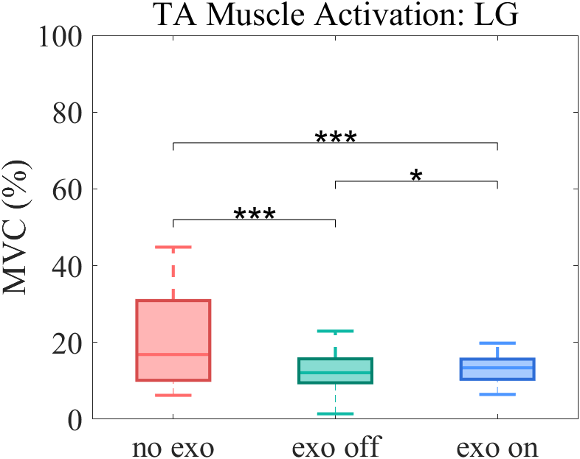
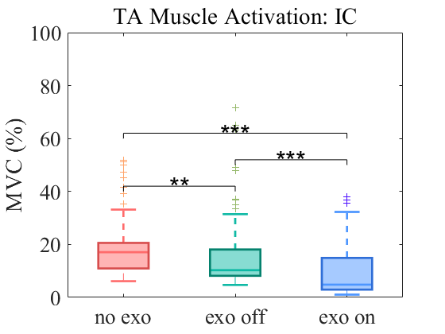
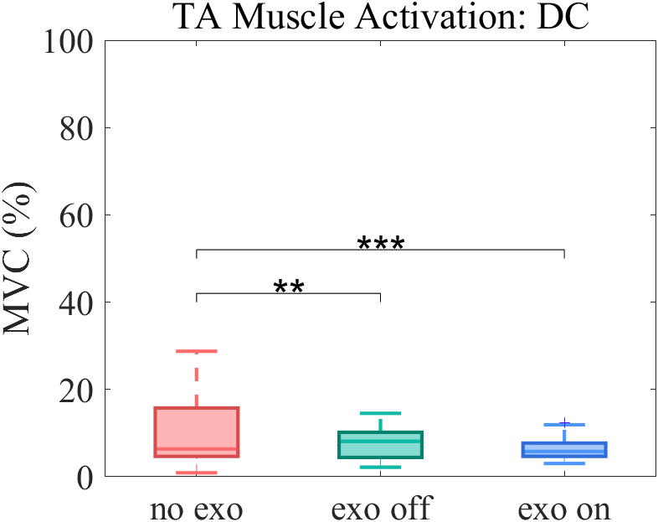
V . Results
Muscle Reduction
(A)
(B)
(C)
average TA muscle activation
LG
IC
DC
no exo
20.63 ± 11.56%
18.44% ± 9.92%
10.75% ± 4.25%
LG, IC: reduction in exo off , exo on condition
exo off
12.77% ± 5.02%
15.24% ± 12.77%
12.34% ± 10.93%
DC: slight increases with exosuit
exo on
13.22% ± 3.43%
9.79% ± 10.12%
12.09% ± 4.81%

Slide 14
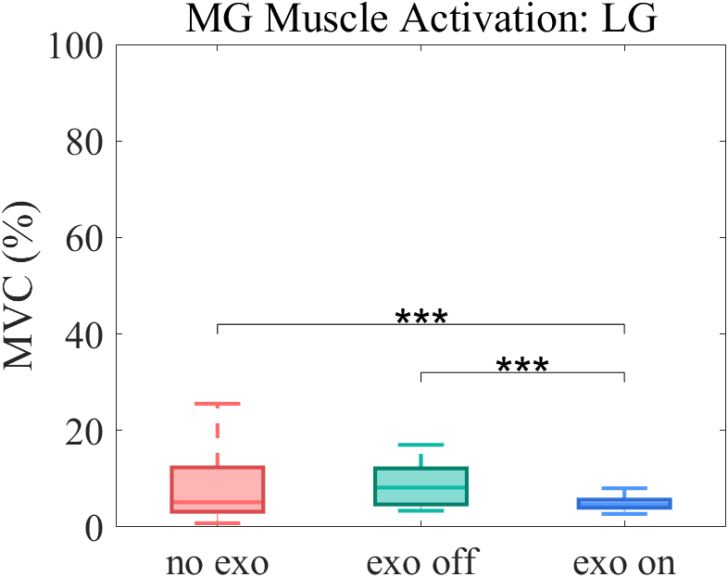
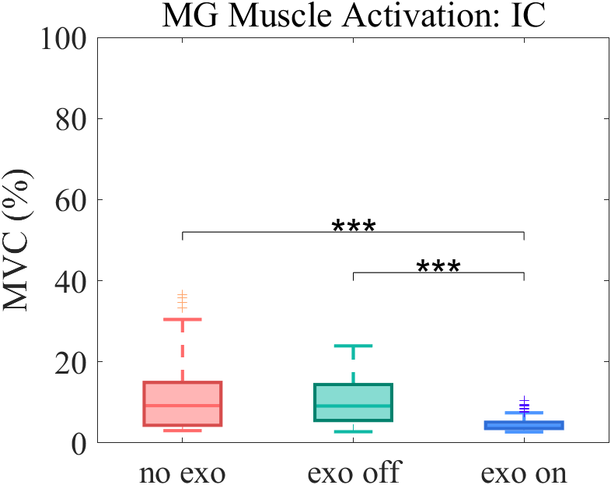
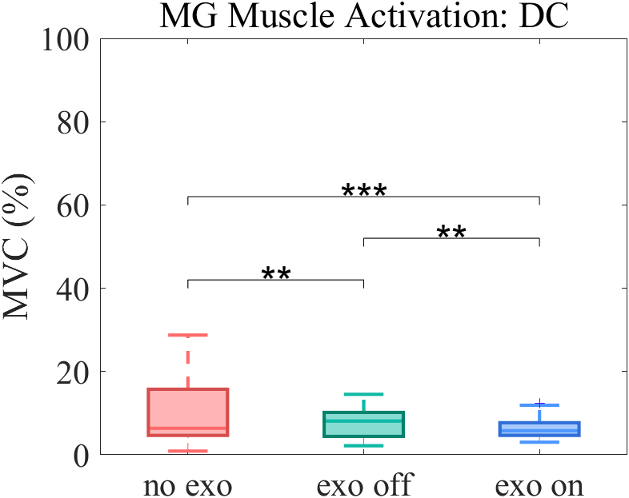
V . Results
Muscle Reduction
(A)
(B)
(C)
average MG muscle activation
LG
IC
DC
no exo
7.88% ± 6.61%
11.71% ± 8.83%
9.97% ± 7.35%
LG, IC, DC: reduction in exo on condition
exo off
8.51% ± 4.04%
10.66% ± 5.99%
7.62% ± 3.41%
exo on
4.87% ± 1.21%
4.70% ± 1.69%
6.41% ± 2.19%

Slide 15
V . Conclusion
Conclusion
vision-based detection algorithm for an ankle exosuit, focusing on improving gait support for stroke patients
integration of YOLOv8 for environment classification and LSTM for spatio-temporal recognition
rapid and accurate classification during gait environment transition
increased ankle dorsiflexion / Reduced TA and MG muscle activation
Future work
Validate across diverse real-world scenarios and multiple stroke patients
Enhance the effectiveness and generalization ability of the exosuit by improving environment classification algorithm

Slide 16


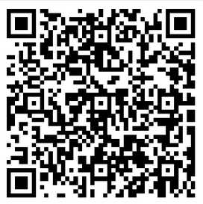
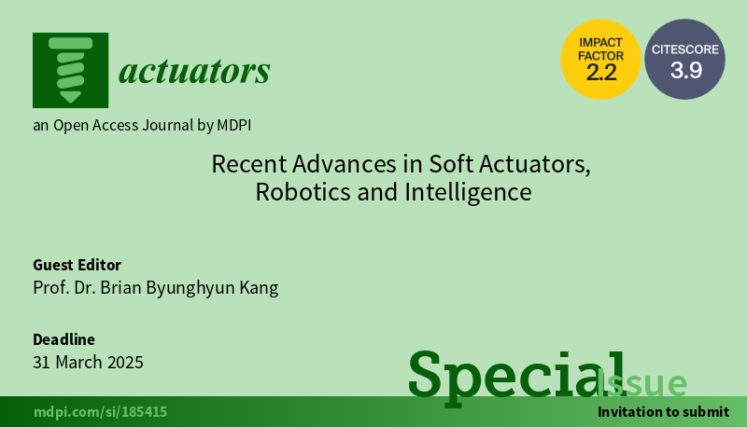
Special Issue: Recent Advances in Soft Actuators, Robotics and Intelligence
Contact us:
Prof. Dr. Brian Byunghyun Kang
brianbkang@sejong.ac.kr
Actuators Editorial Office actuators@mdpi.com
Deadline for manuscript submissions: 31 March 2025
https://www.mdpi.com/journal/actuators/special_issues/L21IU2ZFN9
Call for Paper
This Special Issue will focus on the latest advances in the field of soft technologies for robot realization. Here, we invite you to share your latest findings by submitting high-quality manuscripts that address the following challenges in the field:
Soft actuators and pliable mechanisms in robotics;
Artificial muscles;
Material and structural design of soft actuators;
Soft materials in soft actuators or robots;
…

Slide 17

2024.10.30
Thank You
Gayoung Yang
Intelligence Robotics Lab
School of Intelligent Mechatronics Engineering
Sejong University
Notes:
Thank you for your attention, and I welcome any questions or discussions on our research.
질문 답변이 어려운 경우: I don’t have information about this yet

